Slide 1
Rethinking Memory Management in Modern Operating System — Memory optimization using hardware features and application characteristics
Lei Liu
Sys-Inventor Lab, SKLCA, ICT, CAS
Notes:
Thanks for coming.
Today, I am going present our recent work “rethinking memory management in modern operating system”
This talk will cover several of our recent studies.

Slide 2
Executive Summary
Background & Motivation
Topic 1: Optimization Memory System by OS Approach
Topic 2: Going Vertical!
Topic 3: SYSMON: Making OS understand it!
Topic 4: Our on-going work (if time permits)
Notes:
This is today’s summary. I will give at least 3 topics,
And If time permits I may want to introduce our on-going work

Slide 3
Background & Motivation

Slide 4
Organization of shared memory system
Core 0
Core 1
Core 2
Core N
...
Shared Memory System
Shared Cache
Memory Controller
On-chip
Chip Boundary
Off-chip
DRAM
Bank 0
DRAM
Bank 1
DRAM Bank 2
...
DRAM Bank K
Notes:
Today’s server has several cores on die, they share the LLC, memory controller, bandwidth, and the off-chip DRAM banks. Our study focus on the Shared memory system.
-----------
In modern computer system, the core number in a single die is still increasing. They share last level cache and memory controller and the bandwidth. They are on-chip components,
Main memory system consists of server DRAM banks, and they are shared by all cores. The banks, shared last level cache resource and memory controller are called shared memory system.

Slide 5
Interferences on DRAM Banks -- DRAM Conflicts
Row-Buffer Conflicts
Row-Buffer
2 times Thrashing of Row 1: increases latency
Bank
Memory Latency = N*tRC (Caused by Row-Buffer Thrashing) + I/O Latency
Notes:
Because dram banks are shared by applications, the memory requests from them go to a specific dram bank will definitely incur row-buffer conflicts.
This is an example to show the row-buffer thrashing caused by conflicts. Different color means different memory requests from different threads.
This will incur 2 times thrashing of Row 1, and thus increase memory latency.
Memory latency is equal to N times tRC plus memory I/O latency, where n is the times of row-buffer thrashing , and tRC is its time cost.
----------------
<begin>
Because DRAM BANKS are shared among threads. if several applications are running together, Interference on banks is always a serious problem.
If memory requests go to the different row in the same bank, they have to be moved to the row-buffer one by one, and served one after another. This is so called row-buffer conflicts.
</>
1….2….3…

Slide 6
The Performance Lost -- Caused by Inter-thread Interferences
Shared cache^{[Zhuravlev+,ASPLOS10]}
50% performance degradation
Shared DRAM^{[Moscibroda+,Security06, Onur]}
Unfair: 1.09x v.s. 11.35x
System slowdown: 2.9x v.s. 6x
Impact Overall System Performance and QoS Seriously!
Notes:
The memory interference will lead to performance lost. Many study show that it will impact the overall system performance and QoS seriously.
Many studies try to address this problem.

Slide 7
Topic 1: Optimizing Memory System by OS Approaches -- “Horizontal” Memory Policies
Most of the contents are in our PACT-2012 and ACM TACO-2014 Papers.

Slide 8
Page-Coloring Partitioning Approach
Page-coloring technique has been proposed to partition cache.
Four-way Associativity
Physical address
00
Frame No.
Page Offset
Thread 1
01
Thread 2
Cache Sets
10
Cache Set Bits
Thread 3
11
Thread 4
Notes:
Known to us, Page coloring based last level cache partitioning approach has been successfully used in many commercial products to eliminate the memory interference at last level cache.
-----
We come up with page-coloring partitioning approach. Actually, page coloring technique is not new. It has been used for partition cache.
Let me show you how it works. Given a physical address, processor can use it to lookup in cache by the cache index bits. OS can also use it to indentify a physical page by frame number, and do page allocation. So there are two bits overlapped between cache index and page frame number. These two bits are considered as color-bits. We can use it to partition both physical pages and the cache into four color groups so that one physical page can only go into its corresponding cache sets with the same color.
The idea is pretty nice, using software to partition hardware. But can we use this idea to partition DRAM banks?

Slide 9
Bank bits in PFN
Some bits in Page Frame Number (PFN) denotes the bank address
We could extend page-coloring to partition banks
DRAM Banks
Notes:
Our study shows that there are some bits in page frame number denote the bank address. And thus, we are able to leverage these bits, and extend page coloring to partition dram banks among threads.
--------------
The same reason, there are also some bits denote the bank address. So that it inspire us that we could extend page-coloring to partition DRAM banks.
To this end, we have made 2 key observations that lead to our new mechanism design

Slide 10
Partitioning Banks into Groups
Banks are colored into diff. groups
Thread 1
Thread 2
Thread 3
DRAM Banks
Reducing the available amount of banks that one thread can access
Notes:
This is our goal. Dram banks are colored into different groups. And , it is forbidden that one thread with different color to access other thread’s memory.
Thus, the interferences between threads are eliminated.
But one may raise a question: whether reducing the available amount of banks that one thread can access will impact the performance?
---------
By this partitioning approach, banks are divided into diff. colored groups. Thread can only access its corresponding colored banks, which are assigned at the beginning.
It is forbidden to banks be of other color, which do not belong to it. Apparently, we forbid the all banks across interleaving. It will raise another question, will the limited number of banks impact the overall system performance?
---------
To this end, we have made 2 key observations that lead to our new mechanism design

Slide 11
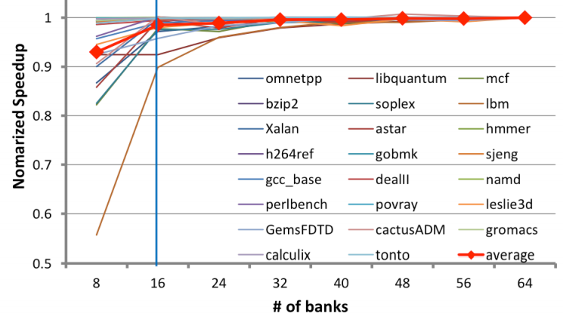
The necessary bank amount
Will this influence performance?
The necessary amount of banks one program
requires is limited
Notes:
we found that the necessary amount of banks that one program requires is limited.
And, 16 banks are enough for most applications. They can achieve over 95% of performance compared to 64 banks.
So it is feasible to partition banks into several groups and map bank groups to specific threads.
--------
But doing exclusively mapping would reduce the available bank amount for one thread. So we need to know whether it would affect application’s performance.
We did experiments on an Intel machine with 64 banks to investigate the correlation between bank number and applications’ performance. Surprisingly, we found that 16 banks are enough for most applications. They can achieve over 95% of performance compared to 64 banks.
So it is feasible to partition banks into several groups and exclusively map bank groups to specific threads.
But how?

Slide 12
Overview of Our Mechanism
Notes:
This is the result of our system. With BPM, on average, the service time of memory system can be reduced.

Slide 13
Bank-level Partition Mechanism (BPM)
Implementation: adopt page-coloring base BPM in Linux kernel 2.6.32 by modifying its buddy system.
group free pages into 32 colors.
Adjust the page allocation algorithm in OS.
Notes:
We get the bank bits in typical machine,
We implement BPM into real linux kernel by modifying the buddy system.
------------------
……
We make change to buddy system in operating system very serious, and we adapt a efficient … algorithm, by which one thread can get its corresponding colored pages effectively.
and adjust the page allocation algorithm so that the thread can get the page with corresponding color efficiently and
effectively.
--------------------
So far, we’ve addressed the mapping challenge. Next, we implement the page-coloring based bank partition mechanism into a Linux kernel.
We modify the buddy system which manages free physical pages in kernel. We make the buddy system group free pages into 32 colors and use a new algorithm for page allocation.
We perform experiments on an Intel machine with 8GB DRAM and 64 banks. The benchmark is SPECCPU 2006 and PARSEC.

Slide 14
Experiment Environment
System Configuration
-- 4-core/8-thread Intel Core i7-860 CPU 2.8GHz
-- LLC: 8MB/16 ways of associativity
Memory Configuration
-- Micron DDR3-1333
-- 2 Channel, 8 Ranks, 64 Banks
Workloads
-- 23 benchmarks from SPEC CPU 2006 (Multi-Program)
-- PARSEC (Multi-Thread)
Notes:
We use real machine that has i7-860 2.8GHz and 8MB last level cache. The memory system is ddr3 dram with 2 channels, 8 ranks, and 64 banks in total.
We use spec 2006 for the multi-programmed workloads. And parsec for multi-threaded workloads.

Slide 15
Experimental Results
System throughput : 4.7%↑ (up to 8.6%)
Maximum slowdown: 4.5%↓ (up to 15.8%)
Memory Power : 5.2% ↓
A Software Memory Partition Approach for Eliminating Bank Level Interferences (PACT-2012)
Notes:
Here are the overall results.
The first step experimental results show that …..
By using the software partition approach, we can achieve system throughput improvement by 4.7% on average and up to 8.6%. The maximum slowdown decreases by 4.5% and up to 15.8%. The approach can also save some memory power.
So this is our software bank-level partition work.

Slide 16
Extend BPM to BPM+
Reducing the Channel Level interferences
“blindly” interleaving
BPM+, Let each thread use a specific channel
BPM/BPM+: Software-based Dynamic Memory Partitioning Mechanism (ACM TACO-2014)
Notes:
Our further work, extend BPM to BPM+, which can reduce the memory channel level interference.
This is the blindly interleaving scheme, and w/ bpm+, we let each thread use a specific channel, and bpm+ also partition memory at dram bank level.
The performance is from eliminating the bank level interferences and the mitigating channel level memory pressure.

Slide 17
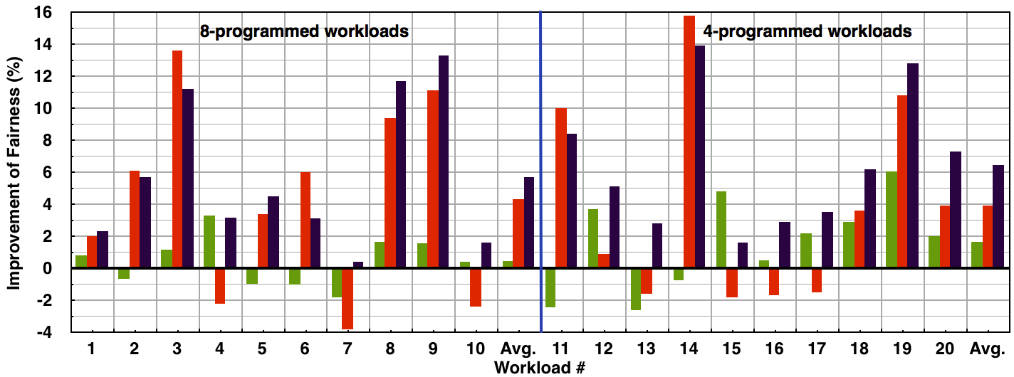
Overall System Performance
Notes:
Compared with BPM, BPM+ further brings additional performance benefits.

Slide 18
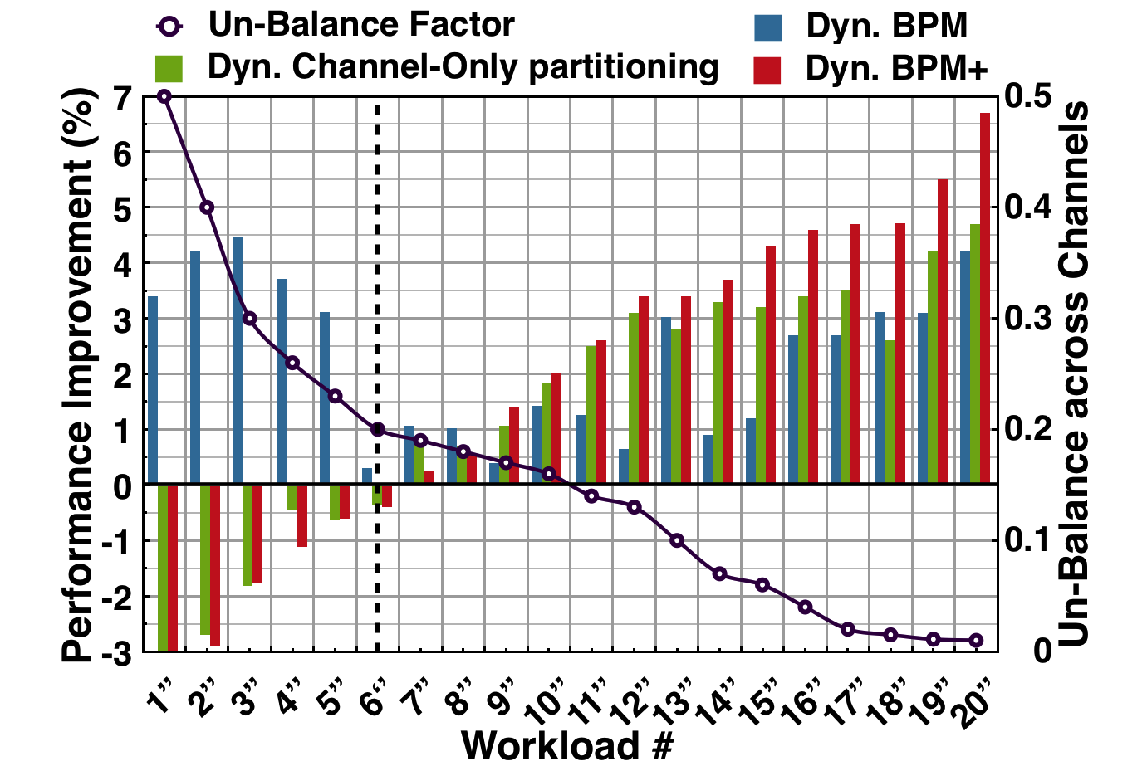
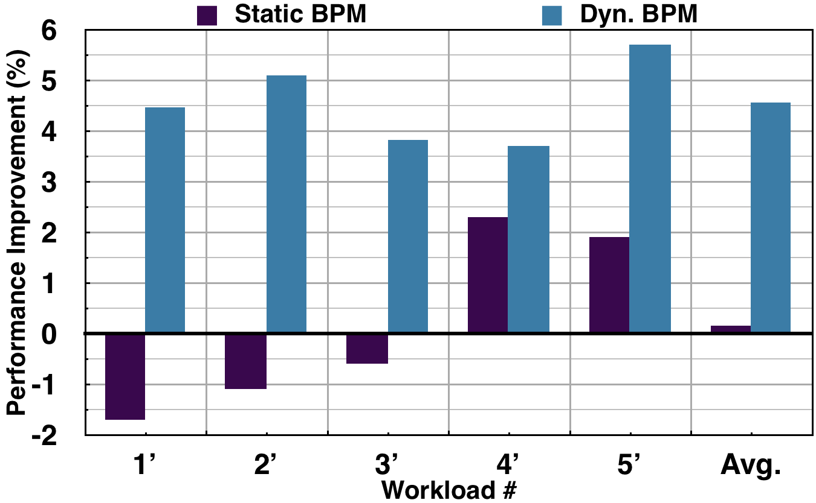
Memory Optimization Framework -- Supporting Dyn. and Flexible Scheduler
Notes:
Our mechanism is dynamic and flexible. You can develop new memory and process scheduler base on it.
For example, by using performance counter, we are able to develop a bandwidth-aware scheduler, which support dynamic memory partitioning.
----
Our mechanism framework supports dynamic optimizations. Using hardware performance counter, we can develop new memory schedulers to support diversity.

Slide 19
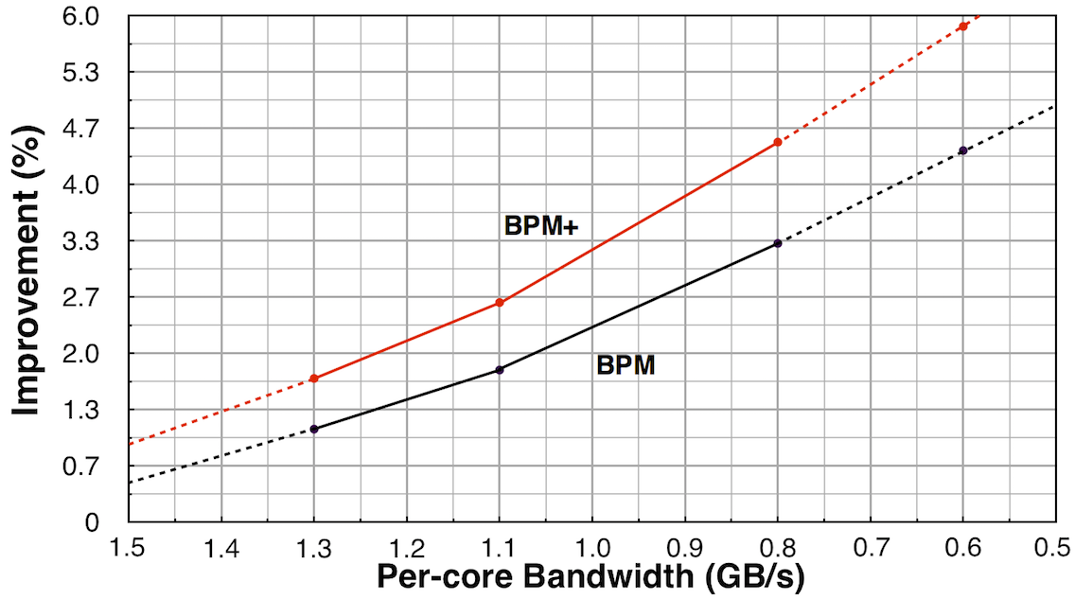
BPM/BPM+ and Per-core Bandwidth
BPM(+) is promising for future multi-/many-core platforms that have even less per-core bandwidth
Notes:
Bpm is promising for future multi-/many-core platforms. We conduct an experiment, with the decreasing of per-core bandwidth, bpm will be more effective.

Slide 20
In What We Win?
A practical software approach for eliminating Bank-level Interferences
-- Without any hardware modification to MC
-- Could be deployed on real system easily
-- Improves both fairness and system throughput
-- Saves energy consumption of memory system
Notes:
Our goal is to ……
To this end,

Slide 21
Topic 2: Going Vertical in Memory Hierarchy -- Exploiting the potential optimization space
Most of the contents are in our ISCA-2014 and IEEE Trans. on Computers-2015 Papers.
Notes:
The above-mentioned contents are so called Horizontal approaches, since the optimizations are only conducted at single level.
This topic is going vertical in memory hierarchy.

Slide 22
Study the Effectiveness of “Horizontal” Partitioning

Slide 23
“Horizontal” Partitioning: Cache VS. DRAM -- Programs are from SPECCPU2006
Whether the two horizontal approaches work cooperatively?

Slide 24
Architecture Features in Modern Multicore Systems
B-/C-/O-Bits in Address Mapping
The address Mapping of Intel i7-860 w/ 8GB Memory
Notes:
We further investigate the physical address mapping in modern computer. we found the address bits can be classified into three categories, Bank bits, Cache bits, and O-bits respectively. The O-bits denote both DRAM Bank and Cache address. The is a concrete example of Intel commercial chip.

Slide 25
“Vertical” Partitioning using O-Bits
Cache Set
Cache Line
T1 T2 T3 T4
Last Level Cache
DRAM Banks
Notes:
Using o-bits, we can vertically partition last cache and dram bank at the same time. We introduce the concept of vertical partitioning, since it can eliminate the memory interferences at both cache level and dram bank level at the same time.

Slide 26
Partitioning Space in Entire Memory Hierarchy
The address Mapping of Intel i7-860 w/ 8GB Memory
Notes:
With vertical, we exploit the potential optimization space. The horizontal ones, and the vertical approaches with different optimizations granularity.
For example,B-vp uses one b-bit + two o-bits, and thus partitions bank level at a finer granularity.

Slide 27
The History of Page-Coloring
--Cross-layer Cooperative Vertical partitioning

Slide 28
The Performance Gains on Vertical Partitioning

Slide 29
They are in the quadrant ONE
How to obtain the workloads’ sensitivity at runtime?
Notes:
These workloads are in quadrant one. Thus, here, we come up to the conclusion that the benefits from bank partitioning and cache partitioning can be accumulated together
But the coming problem is the performance in workload sensitive.

Slide 30
How to Leverage the Potential Optimization Space? -- Combining Application’s Memory Patterns and Hardware Features
Notes:
Then we study how to leverage the potential optimization space

Slide 31
What affects Vertical Partitioning?
Cache sensitivity impacts VP
LLCH: Last Level Cache High Requirement LLCT: LLC Thrashing
LLCM: LLC Middle Requirement CCF: Core Cache Fitting
Notes:
In first step, we classify applications into several types based on their cache sensitivity.
For example, LLCH means the program is with high requirement on LLC, llct means Last Level Cache Thrashing.
---------------
We found cache sensitivity is a factor that impacts the performance of VP. Since vp adds the performance gains of Cache partitioning and Bank partitioning together.
Thus, to make right decision on selecting vertical partitioning, we classify application’s caching behavior into four catoegires, LLCH, LLCT, LLCM and CCF in terms of the cache requirement.
We collect the application's performance slowdown as the LLC capacity is decreasing from 8/8 quota to 1/8 quota. As we can see from the figure, LLCH are those with highest performance degradation. On the other extreme, LLCT shows negligible impact.

Slide 32
The Classification of SPECCPU2006
Diverse memory features on Cache and DRAM
Notes:
Different category indicates different memory behavior.

Slide 33
Data Mining: Classification → Best-Fit Partitioning
Algorithm: Using APRIORI algorithm to discover A → B
Modeling：{lib, mcf, bzip, hmmer} →
{<lib, LLCT>, <mcf, LLCH>, <bzip, LLCM>, <hmmer, CCF>}
→ <cache-only, x%>, <bank-only, y%>, <A/B/C-VP, z%>
Notes:
At second step, we employ data mining algorithm APRIORI to discover the correlation between workloads characteristics and the best-fit partitioning approach.
More details can be found in our paper.

Slide 34
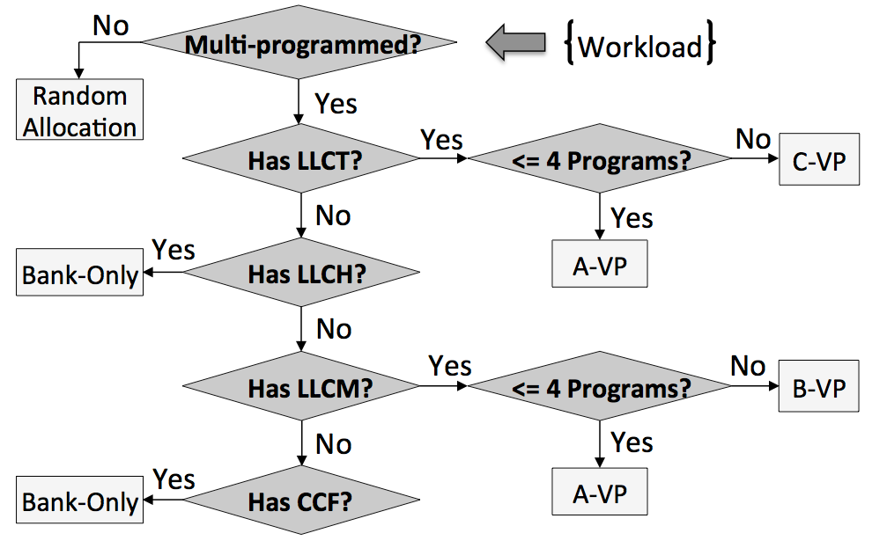
Handling Multiplicity by Multi-policy -- Memory Policy Decision Tree
Who is “stronger”：LLCT > LLCH > LLCM > CCF

Slide 35
Supporting Partitioning and Coalescing -- Real Case: “Curve-Vertical” Partitioning
2xLLCT (e.g. 462.Lib, causing cache thrashing)
4xLLCH or LLCM (e.g. mcf, astar.)
*Principle1*: To isolate LLCT applications since it will interfere other application seriously.
*Principle2*: The number of DRAM Banks one application will use is limited.
15~20% performance benefits, outperforming Cache-/Bank-only “Horizontal” partitioning
IEEE Trans. on Computer-2015

Slide 36
Topic 3: SYSMON -- Making OS understand the memory patterns

Slide 37
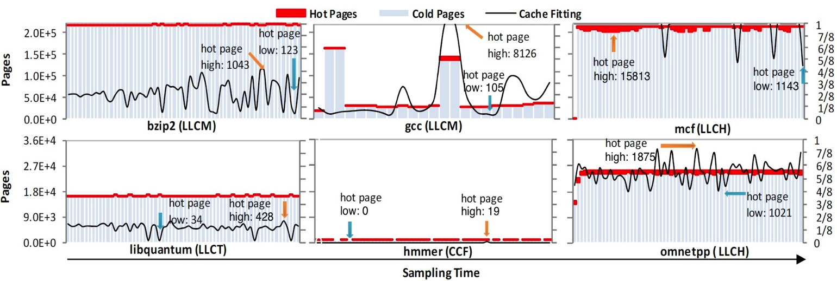
SYSMON: Cache Utilization, Hot/Cold Page, Memory Footprint
It detects __access_bit in PTE, and then distinguishes “cold” and “hot” pages.
It indicates the max requirements of Cache utility of one thread by counting the number of “hot” pages.

Slide 38
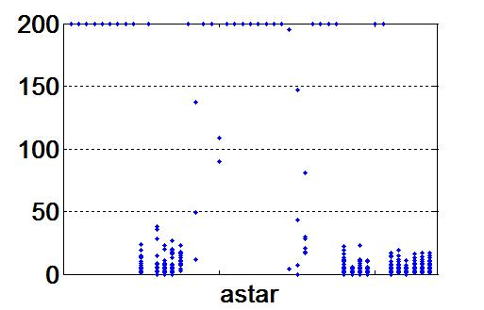
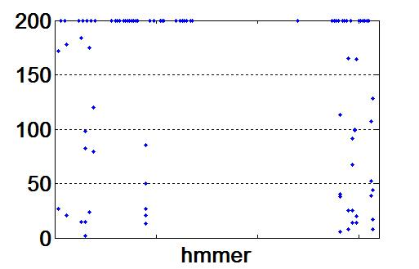
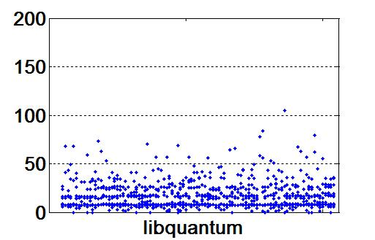
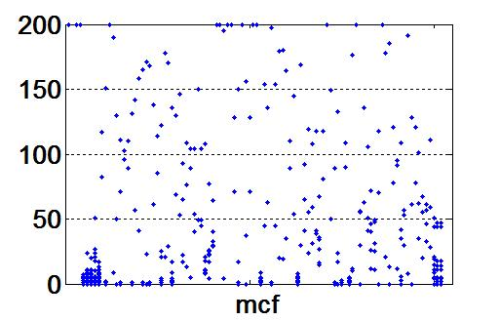
SYSMON: Profiling Page-Level Re-use Time
Lower is better

Slide 39
SYSMON: “Locality” and “Hot” Freq.
Better Locality
Low access Freq.

Slide 40
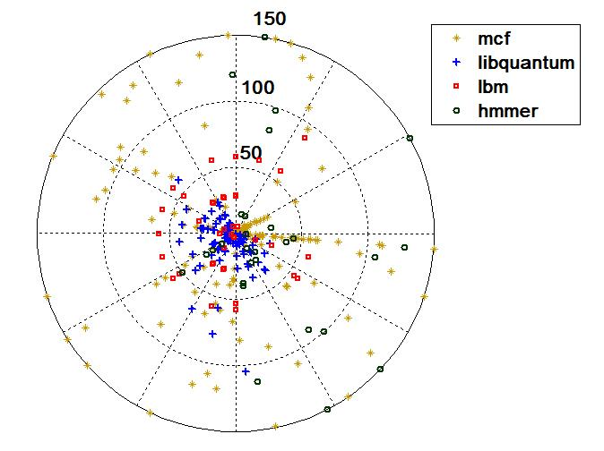
SYSMON: Random Sampling
-- To Handle application with Large Footprint
-- Lower sampling overhead,
but Similar results.
-- Runtime Sampling
-- Easy to be developed
-- Diverse platforms
5~10% PTE is enough to reflect the memory behavior

Slide 41
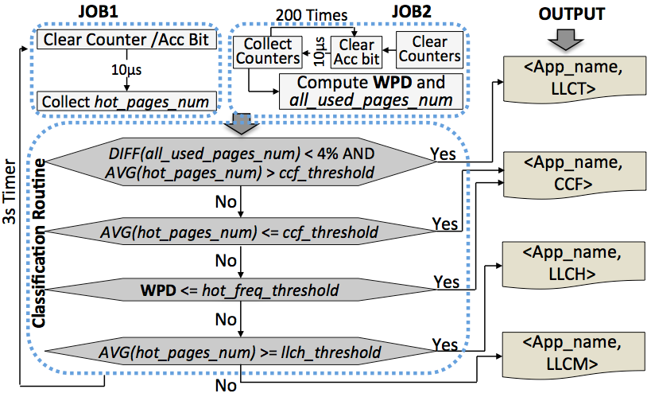
SYSMON: Classification based on Sampling Results
Weighted Page Distribution →“Locality”
WPD= (2xVH + 1.5xH +1xM + 0.5xL + 0.1xVL) / all_used_pages_num

Slide 42
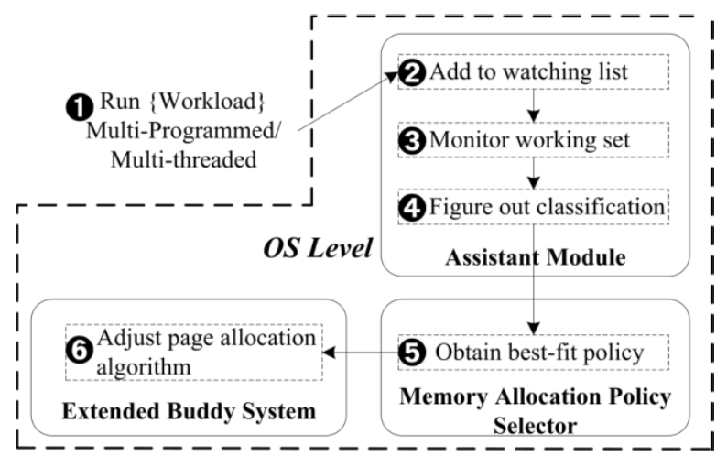
Let it Run On-the-Fly! -- Multi-Policy Framework: Supporting Diverse Memory Allocating Policies

Slide 43
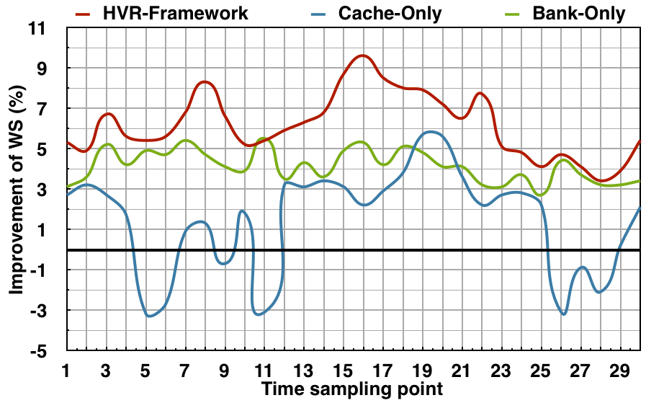
Experimental Results
Horizontal, Vertical, Random (HVR) Framework outperforms the “Horizontal” Partitioning
More experimental results can be found in our paper.
Notes:
In the sampling point 16th, the system achieve higher performance, since our approach uses the vertical partitioning, and enable the coalescing policy for the applications with higher memory requirement.

Slide 44
Topic 4: On Going Work……

Slide 45
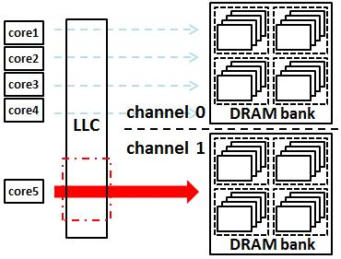
A System Supporting Diversity and Heterogeneity
Providing High Throughput and Quality of Service
1. Asymmetry Multi-Channel (Multi-Channel w/ Multi-Policies)
－Different Applications in Different Channel
－NVM
2. Going Vertical in More Deep
－Channel + BANK + Last Level Cache
3. Bank Balancing Aware System
－Providing Better Bandwidth Utilization
－Improving Bank Parallelism
－Compilation and Runtime Mechanism
4. Memory Scheduling + Partitioning + Random Interleaving
－Locality-Aware System
－Task Assignment

Slide 46
A Case for Heterogeneous and Memory Intensive Architecture
OS Physical Page Allocating
OS Level
Monitor
OS
Hardware
DRAM
Page Migration
PCM/STT
Writing Domain
Reading Domain
Multi-Channel with Multi-Policies to support Heterogeneous Memory System
Operating System supports “Computing Near Memory”
Understanding the memory patterns, and then Guide the memory policies, and data (re-)organization

Slide 47
Conclusion
Horizontal and Vertical Partitioning
-- Brings up to 21% improvement
-- Outperforms the Horizontal partitioning
Closing the “gap” between arch. and OS
-- Makes OS take advantages of arch. Features
-- Application-Arch.-Aware Memory Management (HVR)
Memory optimization
-- We try to approach it from OS angle
-- Optimizes the memory allocating/organizing in the root

Slide 49
DRAM Organization －From the View of MC
Notes:
From the view of Memory Controller, memory system is consisted of several dram bank, and each dram bank has a row-buffer.
each line will be moved to row-buffer, and then can be operated.
我们研究的目标是DRAM系统，在内存控制器的眼里，它由若干个Bank构成，每个BANK均有一个row buffer(行缓冲)，它的作用至为关键。数据的读写，都必须从Bank中读到row-buffer里才能进行。“行缓冲”的设计，带有微体系结构的特点，蕴含着“局部性”优化的原理。

Slide 50
Row-buffer miss rate
Reduced row buffer miss by BPM depends on workloads’ features (5%~10%)
A Software Memory Partition Approach for Eliminating Bank Level Interferences (PACT-2012)

Slide 51
BPM for Multi-threaded
Streamcluster from Parsec 2.0
Partition the input data by a straightforward way
The improvement is less than Multi-Programmed
-- 1.7% and 2.3% on 4/8-threaded separately
-- Because there are too much shared data
Our future work will study these issues

Slide 52
Random Interleaving
Random Interleaving for Multi-threaded workloads
Thread 1
Thread 2
Thread 3
DRAM Banks
The more randomized,
the higher performance will be achieved
Notes:
Quite different with partitioning “idea” is random interleaving

Slide 53
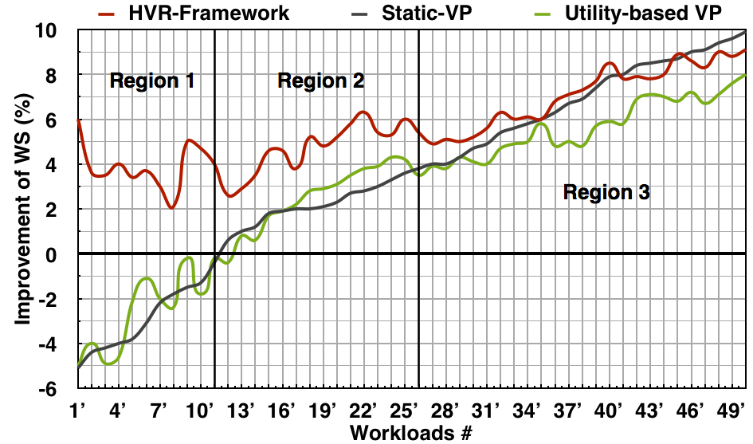
Horizontal Vertical Random Framework (1)
Get the proper memory allocating policy
Use the partitioning and coalescing
LLCM
A/B-VP
LLCH
Bank-Only
LLCT
A/C-VP
Notes:
For different workloads, Our framework can get the proper memory allocating policy in terms of application’s classification, and use the partitioning and coalescing for more performance. For example, in region 1, there are llch domanate workloads, so it use bank partitioning and thus avoid the performance lost.
In region 2, there are LLCT domaniate workloads, so the partitioning and coalescing rule will benefit the performance.

Slide 54
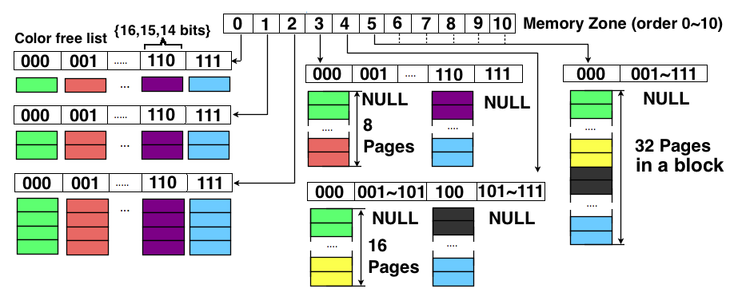
X-buddy: Supporting Multi-policy (1)
Sub-System A (O-bit 14,15,C-bit 16 bit)→A-/C-VP
Allocating physical pages in terms of colors

Slide 55
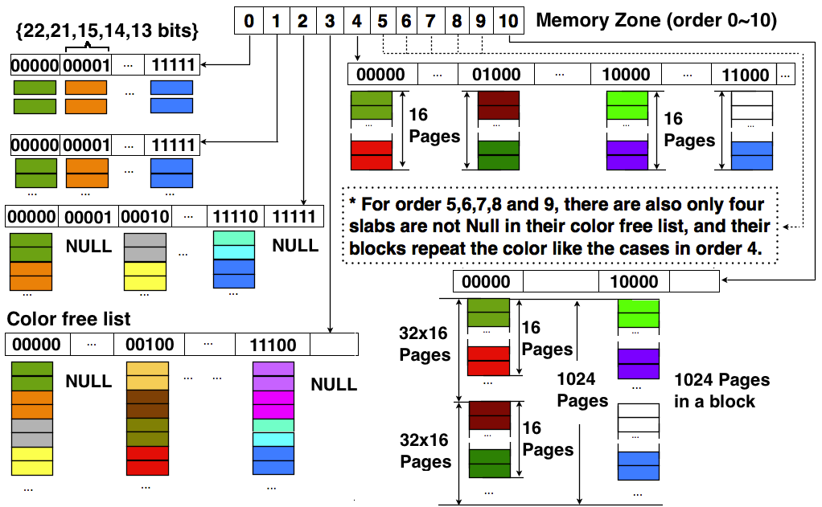
X-buddy: Supporting Multi-policy (2)
Sub-System B (O-bits 13,14,15,B-bits 21,22 bits)→Bank-Only/B-VP
Support interleaving by random or Round-Robin selecting pages in Order-1 list

Slide 56
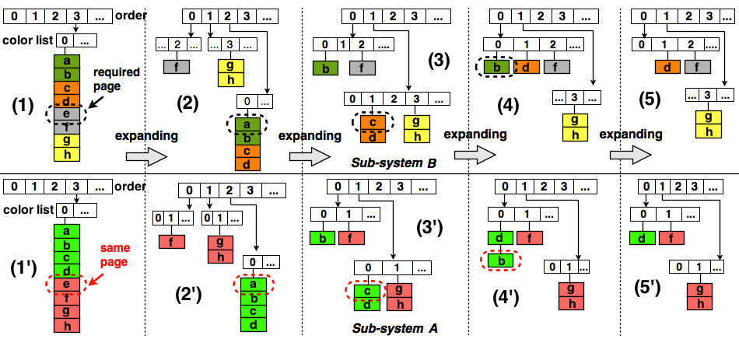
Sub-System A and B work together
We can get page with target color in O(1)

